Slide 1
NATIONAL INSTITUTE OF TECHNOLOGY SILCHAR
Cachar, Assam
B.Tech. VIIIth Sem
Topic : Localisation and Positioning
Subject Code : CS-442
Subject Name : Wireless Sensor Network
Submitted By:
Subhojit Ghimire
1912160
CSE-B

Slide 2
Introduction
Localisation and positioning are means for a node to determine its physical position (with respect to some coordinate system) or symbolic location using the help of anchor nodes that know their position.
Localisation and positioning can be done using different means to determine distances or angles between nodes, such as received signal strength indicator (RSSI), time of arrival (ToA), time difference of arrival (TDoA), or directional antennas.
Localisation and positioning can be classified into two categories:
Range-based: Range-based methods use distance or angle estimates to compute the position of a node using simple geometry, such as trilateration or angulation.
Range-free: Range-free methods use connectivity information or proximity to anchor nodes to estimate the position of a node without using distance or angle measurements.
Localisation and positioning can be done in a centralized or distributed manner. Centralized methods require a central node or server to collect and process the information from all nodes and compute their positions. Distributed methods allow each node to compute its own position using local information from its neighbours.
Localisation and positioning have different metrics to evaluate their performance, such as accuracy, precision, scalability, robustness, energy consumption, and cost.

Slide 3
Properties of Localisations and Positioning Procedures
Physical position versus symbolic location: Physical position refers to the data about the coordinates of a node in a given coordinate system, such as geographic or Cartesian. Symbolic location refers to the data about the logical or semantic location of a node, such as in a room or near a landmark.
Absolute versus relative coordinates: Absolute coordinates are valid for all objects and require anchor nodes that know their position. Relative coordinates are valid only for a subset of objects and do not require anchor nodes.
Localised versus centralised computation: Localised computation means that each node computes its own position using local information from its neighbours. Centralised computation means that a central node or server collects and processes the information from all nodes and computes their positions.
Accuracy and precision: Accuracy measures how close an estimated position is to the real position. Precision measures how often a given accuracy is achieved for repeated position determinations.
Scale: Scale refers to the size and scope of the network and the application. Different scales may require different localization and positioning methods, such as indoors, outdoors, or global.
Limitations: Limitations refer to the factors that may affect the performance or feasibility of localization and positioning methods, such as environmental noise, multipath fading, mobility, interference, synchronization, calibration, or hardware requirements.
Costs: Costs refer to the resources that are consumed or required by localization and positioning methods, such as energy, bandwidth, memory, computation, or hardware.

Slide 4
Possible Approaches – Proximity and Triangulation
Proximity:
Overlapping connectivity: This method estimates the position of a node in the center of the area where the circles from which signal is heard or not heard overlap.
Approximate point in triangle: This method determines the triangles of anchor nodes where the node is inside, overlaps them, and checks whether inside a given triangle by moving the node or simulating movement by asking neighbors.
Proximity based on received signal strength indicator (RSSI): This method uses the signal strength of a known transmitted signal and a path loss coefficient to estimate the distance between nodes.
Proximity based on time of arrival (ToA) or time difference of arrival (TDoA): This method uses the time of transmission, propagation speed, and time of arrival of different signals (such as radio and ultrasound) to estimate the distance between nodes.
Proximity based on directional antennas: This method uses directional antennas on the nodes or on the anchors to measure the angle between nodes.
Triangulation:
Triangulation based on directional antennas: This method uses directional antennas on the nodes or on the anchors to measure the angle between nodes, and then uses three or more angle estimates to compute the position of a node using simple geometry.

Slide 5
Possible Approaches – Trilateration and Scene Analysis
Trilateration:
Trilateration based on received signal strength indicator (RSSI): This method uses the signal strength of a known transmitted signal and a path loss coefficient to estimate the distance between nodes, and then uses three or more distance estimates to compute the position of a node using simple geometry.
Trilateration based on time of arrival (ToA) or time difference of arrival (TDoA): This method uses the time of transmission, propagation speed, and time of arrival of different signals (e.g.: radio and ultrasound) to estimate the distance between nodes, and then uses three or more distance estimates to compute the position of a node using simple geometry.
Trilateration based on point in triangle testing: This way selects 3-special neighbour anchors that form the smallest triangle enclosing the unknown node, then uses their distance estimates to compute the position of the node using simple geometry.
Scene Analysis:
Scene analysis based on video or image processing: This method uses cameras or other imaging devices on the nodes or on the anchors to capture the visual features of the environment and compare them with a pre-stored database to estimate the position of a node.
Scene analysis based on electromagnetic characteristics: This method uses radio frequency identification (RFID) tags or other electromagnetic devices on the nodes or on the anchors to measure the electromagnetic properties of the environment and compare them with a pre-stored database to estimate the position of a node.
Scene analysis based on fingerprinting: This method uses RSSI or other signal measurements on the nodes or anchors to create a radio map of the environment and compare it with a pre-stored database to estimate the position of a node.

Slide 6
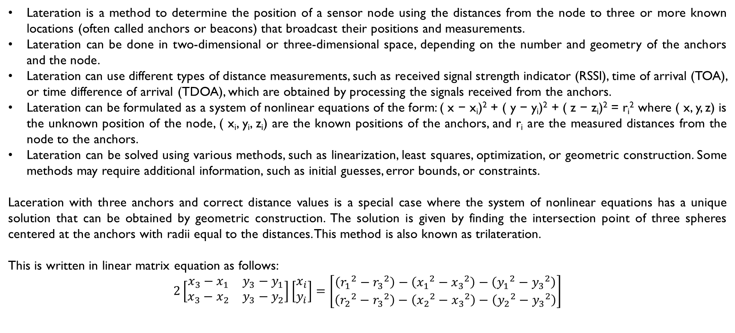
Mathematical Basis for the Lateration Problem –
Solution with Three Anchors and Correct Distance Values
Lateration is a method to determine the position of a sensor node using the distances from the node to three or more known locations (often called anchors or beacons) that broadcast their positions and measurements.
Lateration can be done in two-dimensional or three-dimensional space, depending on the number and geometry of the anchors and the node.
Lateration can use different types of distance measurements, such as received signal strength indicator (RSSI), time of arrival (TOA), or time difference of arrival (TDOA), which are obtained by processing the signals received from the anchors.
Lateration can be formulated as a system of nonlinear equations of the form: ( x − x_{i})² + ( y − y_{i})² + ( z − z_{i})² = r_{i}² where ( x, y, z) is the unknown position of the node, ( x_{i}, y_{i}, z_{i}) are the known positions of the anchors, and r_{i} are the measured distances from the node to the anchors.
Lateration can be solved using various methods, such as linearization, least squares, optimization, or geometric construction. Some methods may require additional information, such as initial guesses, error bounds, or constraints.
Laceration with three anchors and correct distance values is a special case where the system of nonlinear equations has a unique solution that can be obtained by geometric construction. The solution is given by finding the intersection point of three spheres centered at the anchors with radii equal to the distances. This method is also known as trilateration.
This is written in linear matrix equation as follows:
$$2\left[\begin{matrix}x_{3}−x_{1} & y_{3}−y_{1} \\ x_{3}−x_{2} & y_{3}−y_{2}\end{matrix}\right]\left[\begin{matrix}x_{i} \\ y_{i}\end{matrix}\right]=\left[\begin{matrix}\left({r_{1}}^{2}−{r_{3}}^{2}\right)−\left({x_{1}}^{2}−{x_{3}}^{2}\right)−\left({y_{1}}^{2}−{y_{3}}^{2}\right) \\ \left({r_{2}}^{2}−{r_{3}}^{2}\right)−\left({x_{2}}^{2}−{x_{3}}^{2}\right)−\left({y_{2}}^{2}−{y_{3}}^{2}\right)\end{matrix}\right]$$

Slide 7
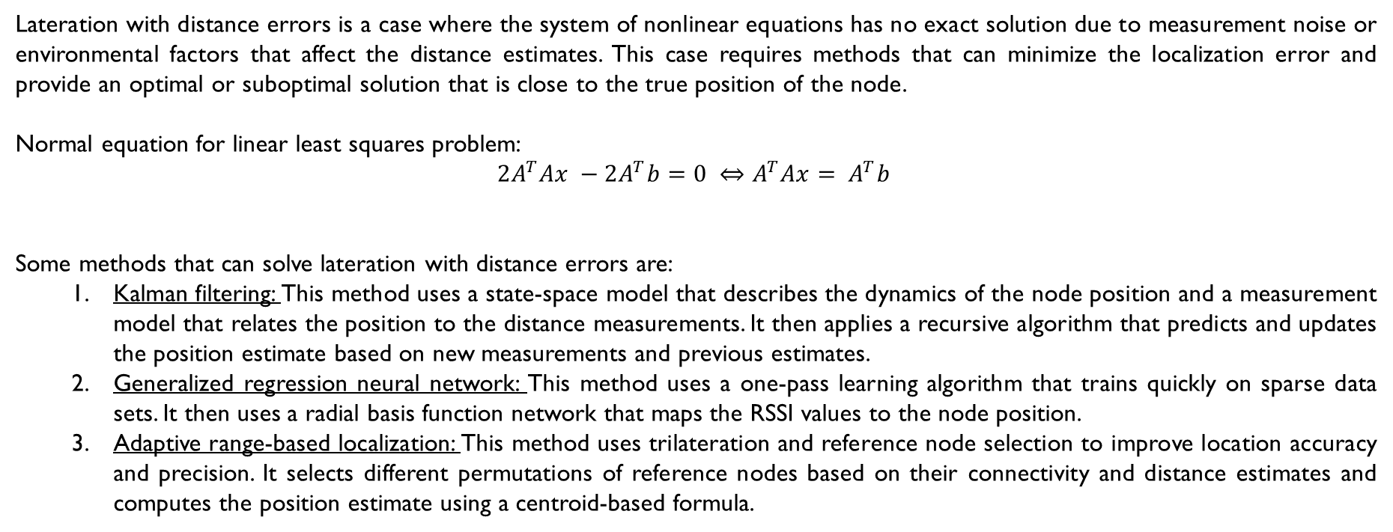
Mathematical Basis for the Lateration Problem –
Solving with Distance Errors
Lateration with distance errors is a case where the system of nonlinear equations has no exact solution due to measurement noise or environmental factors that affect the distance estimates. This case requires methods that can minimize the localization error and provide an optimal or suboptimal solution that is close to the true position of the node.
Normal equation for linear least squares problem:
$$2A^{T}Ax −2A^{T}b=0 ⇔A^{T}Ax= A^{T}b$$
Some methods that can solve lateration with distance errors are:
Kalman filtering: This method uses a state-space model that describes the dynamics of the node position and a measurement model that relates the position to the distance measurements. It then applies a recursive algorithm that predicts and updates the position estimate based on new measurements and previous estimates.
Generalized regression neural network: This method uses a one-pass learning algorithm that trains quickly on sparse data sets. It then uses a radial basis function network that maps the RSSI values to the node position.
Adaptive range-based localization: This method uses trilateration and reference node selection to improve location accuracy and precision. It selects different permutations of reference nodes based on their connectivity and distance estimates and computes the position estimate using a centroid-based formula.

Slide 8
Single Hop Localisation Systems
Single hop localization is a method where a node with unknown position can directly communicate with anchors that broadcast their positions and measurements.
Active badge: This system uses diffused infrared as transmission medium and exploits the natural limitation of infrared waves by walls as a means of localization. Every badge periodically sends a unique identifier via infrared to receivers, at least one of which is installed in every room. The receivers then send this identifier to a central server that stores the location info of the badges.
Active office: This system uses ultrasound as transmission medium and performs trilateration to estimate the position of a node. The devices for which the position is to be determined act as ultrasound senders and the receivers are placed at well-known positions, mounted in an array at the ceiling of a room. The receivers measure the time difference of arrival of ultrasound and radio signals from the senders and compute their distances using the propagation speed. The position of the sender is then calculated using geometric construction.
RADAR: This system uses scene analysis techniques based on received signal strength indicator (RSSI) to estimate the position of a node. Both the anchors and the mobile device can be used to send the signal, which is then measured by the other nodes. The signal strength is compared with a pre-stored radio map of the environment to find the best match for the node position.
Cricket: It is a system that uses time difference of arrival (TDOA) to estimate the distance between nodes. It uses two different signals with different propagation speeds: ultrasound and radio. The nodes measure the difference between arrival times of ultrasound and radio signals from the anchors and compute their distances using the propagation speed. The position of the node is then calculated using trilateration.
Using angle of arrival information: This method uses directional antennas on the nodes or on the anchors to measure the angle between nodes. The angle of arrival (AoA) info can be used to estimate the position of a node using triangulation or other geometric methods. However, this method may require additional info, such as axis orientations, synchronization, or calibration.

Slide 9
Contd… Single Hop Localisation Systems
Overlapping connectivity:
It is a method that uses information about a node’s neighbourhood to estimate its position. It exploits the finite range of wireless communication and assumes that a node can hear or not hear signals from the anchors.
It estimates the position of a node in the centre of the area where the circles from which signal is heard or not heard overlap. The radius of each circle is determined by the transmission range of the anchor. The node can use simple geometry to find the intersection point of the circles.
It is a range-free method that does not require distance or angle measurements. It only requires connectivity information or proximity to anchor nodes. However, it may not be very accurate or precise due to environmental noise, interference, or irregular transmission ranges.
Approximate point in triangle (APIT):
It is a method that uses information about a node’s neighbourhood to estimate its position. It exploits the geometric properties of triangles formed by anchor nodes and determines whether a node is inside or outside a triangle.
It determines the triangles of anchor nodes where the node is inside, overlaps them, and checks whether inside a given triangle by moving the node or simulating movement by asking neighbours. The position of the node is then estimated as the centroid of the overlapping area.
It is a range-free method that does not require distance or angle measurements. It only requires connectivity information or proximity to anchor nodes. However, it may not be very accurate or precise due to environmental noise, interference, or irregular transmission ranges.

Slide 10
Positioning in Multihop Environments – Connectivity in Multihop Network
A semidefinite program feasibility formulation
Positioning in Multihop Environments
It is a method to determine the position of a node using the distances or angles from the node to multiple known locations (often called anchors or beacons) that broadcast their positions and measurements. The node may not be able to communicate with the anchors directly, but through intermediate nodes that relay the information.
It can use different types of distance or angle measurements, such as received signal strength indicator (RSSI), time of arrival (TOA), time difference of arrival (TDOA), or angle of arrival (AOA), which are obtained by processing the signals received from the anchors or the intermediate nodes.
It can use different types of algorithms or techniques, such as centralized or distributed localization, range-based or range-free localization, trilateration or triangulation, scene analysis or proximity, etc. having different advantages and disadvantages in terms of accuracy, precision, scalability, robustness, complexity, or energy consumption.
Connectivity in Multihop Network – A semidefinite program feasibility formulation
It is a method to determine the position of a node using the connectivity information between nodes. It assumes that two nodes are connected if and only if their distance is less than a given threshold.
It formulates the localization problem as a semidefinite program (SDP) feasibility problem. It uses a matrix variable to represent the positions of all nodes and imposes linear matrix inequalities (LMIs) to ensure that the connectivity constraints are satisfied. It then solves the SDP feasibility problem using interior point methods or other numerical methods.
This range-free method does not require distance or angle measurements. It only requires connectivity info between nodes. However, it may not be accurate/precise due to measurement noise, environmental factors, or irregular transmission ranges.

Slide 11
Positioning in Multihop Environments – Connectivity in Multihop Network
Multidimensional Scaling and Multihop Range Estimation
Connectivity in Multihop Network – Multidimensional Scaling
It is a method to determine the position of a node using the distance estimates between nodes. It assumes that the distance estimates are obtained by using RSSI, TOA, TDOA, or other methods.
It formulates the localization problem as a multidimensional scaling (MDS) problem. It uses a matrix variable to represent the distance estimates between all pairs of nodes and imposes objective function to minimise stress between distance estimates and actual distances. It then solves the MDS problem using gradient descent methods or other numerical methods.
It is a range-based method that requires distance estimates between nodes. It can achieve high accuracy and precision if the distance estimates are reliable and consistent. However, it may be affected by measurement noise, environmental factors, or irregular transmission ranges.
Multihop Range Estimation
It is a method to estimate the distance between a node and an anchor that are not within direct communication range. It uses intermediate nodes that relay the distance information between the node and the anchor.
It can use different types of distance measurements, such as RSSI, TOA, TDOA, or other methods. It can also use different types of algorithms or techniques, such as hop count, average hop size, maximum likelihood estimation, etc. Different methods may have different accuracy and complexity depending on the network topology and environmental factors .
It is a range-based method that requires distance measurements between nodes. It can improve the localization performance by increasing the number of anchors that can be used for positioning. However, it may also introduce errors due to measurement noise, interference, or irregular transmission ranges.

Slide 12
Positioning in Multihop Environments – Iterative and Collaborative
Multilateration & Probabilistic Positioning Description and Propagation
Iterative and collaborative multilateration
This method determines position of node using the distances from node to multiple anchors that broadcast their positions and measurements. It uses an iterative process that involves collaboration among nodes to refine their position estimates.
It can use different types of distance measurements, such as RSSI, TOA, TDOA, or other methods. It can also use different types of algorithms or techniques, such as least squares, Kalman filtering, particle filtering, etc. Different methods may have different convergence and robustness properties depending on the network topology and environmental factors .
It is a range-based method that requires distance measurements between nodes. It can achieve high accuracy and precision by exploiting the redundancy and diversity of information among nodes. However, it may also incur high communication and computation overhead due to the iterative and collaborative process.
Probabilistic positioning description and propagation
It is a method to determine the position of a node using the probability distributions of its possible positions based on the information from multiple anchors that broadcast their positions and measurements. It uses a probabilistic model that describes the uncertainty and error of the position estimates.
It can use different types of information sources, such as distance measurements, angle measurements, connectivity information, or scene analysis information. It can also use different types of algorithms or techniques, such as Bayesian inference, belief propagation, Monte Carlo methods, etc. Different methods may have different accuracy and complexity depending on the network topology and environmental factors .
It is a general method that can incorporate both range-based and range-free information sources. It can provide a more realistic and flexible representation of the position estimates by accounting for uncertainty and error.

Slide 13
Impact of Anchor Placement
Anchor placement is a problem of determining the optimal positions and number of anchor nodes that broadcast their positions and measurements to help other nodes localize themselves. Anchor placement can affect the localization performance in terms of accuracy, precision, coverage, scalability, robustness, complexity, or energy consumption.
Anchor placement can be done using different criteria or objectives, such as minimizing localization error, maximizing network coverage, minimizing anchor deployment cost, maximizing network connectivity, etc. Different criteria or objectives may have different trade-offs and challenges depending on the network topology and environmental factors .
Anchor placement can be done using different methods or techniques, such as analytical methods, heuristic methods, optimization methods, learning methods, etc. Different methods or techniques may have different advantages and disadvantages in terms of computational complexity, solution quality, adaptability, or flexibility.
Examples of Anchor Placement Methods:
Outlier detection and optimal anchor placement for 3-D underwater optical wireless sensor network localization
Mobile anchor node assisted localization (MANAL) algorithm
Geometric routing

Slide 14
Further Reading
GPS: Global Positioning System (GPS) is a satellite-based system that provides location and time information to receivers on Earth. GPS can be used for WSN localization and positioning by equipping some or all sensor nodes with GPS receivers. However, GPS may not be feasible for large-scale or indoor WSNs due to cost, power consumption, or signal availability issues.
Angulation: Angulation is a method to determine the position of a node using the angles from the node to multiple known locations (often called anchors or beacons) that broadcast their positions and measurements. Angulation can use different types of angle measurements, such as angle of arrival (AOA), which are obtained by using directional antennas on the nodes or on the anchors. Angulation can be formulated as a system of nonlinear equations that can be solved using various methods, such as linearization, least squares, optimization, or geometric construction.
Error impact: It is a measure of how the localization performance is affected by various sources of uncertainty in WSNs. Error sources can include measurement noise, environmental factors, irregular transmission ranges, anchor position errors, etc. Error impact can be evaluated using different metrics, such as localisation error, network coverage, network connectivity, etc. Error impact can be mitigated by using different methods or techniques, such as outlier detection, robust estimation, error correction, etc.
Anchor-free systems: Anchor-free systems are systems that do not require any anchor nodes that broadcast their positions and measurements to help other nodes localize themselves. Anchor-free systems can use different methods or techniques, such as proximity, scene analysis, hop count, etc. Anchor-free systems can be advantageous in terms of cost, scalability, robustness, or flexibility. However, anchor-free systems may not be very accurate or precise due to lack of absolute reference points.

Slide 15
Further Reading Contd… & Conclusion
Performance: It is a measure of how well a localization and positioning system achieves its objectives and requirements. Performance can be evaluated using different criteria or objectives, such as accuracy, coverage, scalability, robustness, complexity etc. Performance can be improved by using different methods or techniques, such as optimal anchor placement, mobile anchor nodes, iterative and collaborative multilateration, probabilistic positioning description and propagation, etc.
Nonstandard approaches: Nonstandard approaches are approaches that use novel or unconventional methods or techniques for WSN localization and positioning. Nonstandard approaches can include using non-Euclidean geometry, quantum mechanics, machine learning, bio-inspired algorithms, etc. Nonstandard approaches can provide new insights or solutions for challenging or complex WSN localization and positioning problems.
Conclusion:
Localisation and positioning in WSN is an important and challenging research field that aims to provide location information for sensor nodes that collect and process data in various applications. It can use different types of information sources, such as distance, angle, connectivity, or scene analysis, and different types of algorithms or techniques, such as trilateration, triangulation, multilateration, multidimensional scaling, etc. Additionally, it can also use different types of systems, such as anchor-based or anchor-free systems, single-hop or multihop systems, range-based or range-free systems, etc. It can be evaluated and improved using different criteria or objectives, such as accuracy, precision, coverage, scalability, robustness, complexity, energy consumption, etc. It can also benefit from novel or unconventional methods or techniques, such as non-Euclidean geometry, quantum mechanics, machine learning, bio-inspired algorithms, etc. Localisation and positioning is a rich and diverse research field that has many potential applications and challenges.

